Slide 1
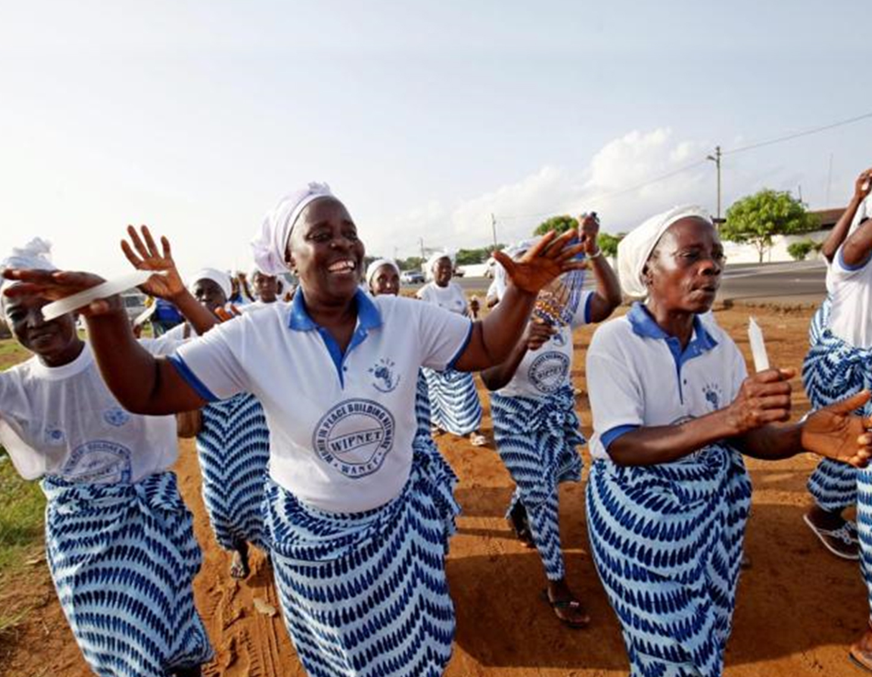
WHO work on the review of safety signal and technical guidance on toxicity monitoring and pregnancy safety surveillance of dolutegravir.
Françoise Renaud- WHO HIV Department. WHO Satellite - AIDS 2018 Friday 27 July 2018
No Conflict of Interest
www.who.int

Slide 2
WHO statement and Q&A on potential safety issue related with dolutegravir (DTG)
WHO Medical Product Alert
  Statement on DTG – Geneva, 18 May 2018 "Potential safety issue affecting women living with HIV using dolutegravir at the time of conception"
  At link: http://www.who.int/medicines/publications/drugalerts/en/
  Action to start to inform the discussions and guide decision-making
  Questions and Answers (Q&A) document on DTG use in women of childbearing age – Geneva , 21 May 2018
  At link: http://www.who.int/hiv/WHO_q-and-a-DTG-21may2018.pdf?ua=1

Slide 3
WHO Global work on the safety signal of DTG (1)
Normative work
  Sub-committee on safety of dolutegravir established - July 2018
  Report to WHO Advisory Committee on Safety of Medical Products (ACSoMP) and ART Guidelines Development Group
  Review and assess data and on-going studies in relation with the NTD signal and any safety issues in pregnancy
  Potential INSTIs class effect
  1st meeting in September and regularly convened as new data become available
  Objective: refute or confirm the safety signal

Slide 4
WHO work on safety signal of DTG (2)
Technical support to countries on DTG transition plans
  ART national policy revisions - HIV
  Procurement issues - HIV
  PV system preparedness and DTG toxicity monitoring and surveillance – EMP & HIV
WHO technical and convening role with:
    researchers and partners engaged in surveillance and trials - HIV
    regulatory authorities esp. FDA and EMA - EMP
    marketing authorization holders (MAHs) - EMP
    public: Media Centre, Pharmaceutical Newsletter, technical updates, drug alert – HIV & EMP

Slide 5
Timeline for WHO normative work
September 2018
April 2019
1st meeting of WHO sub-committee on safety of dolutegravir:
Review all safety reports on DTG from all sources incl. periodic safety updates by MAHs to FDA and EMA, trials and studies in countries
Safety Assessment
Recommendations for follow up and investigation
WHO ACSoMP Annual Meeting:
First report by the sub-committee
Safety assessment
Recommendations to WHO to guide and advice the WHO Member States, policy makers and health professionals
Recommendations for follow up and investigation

Slide 6
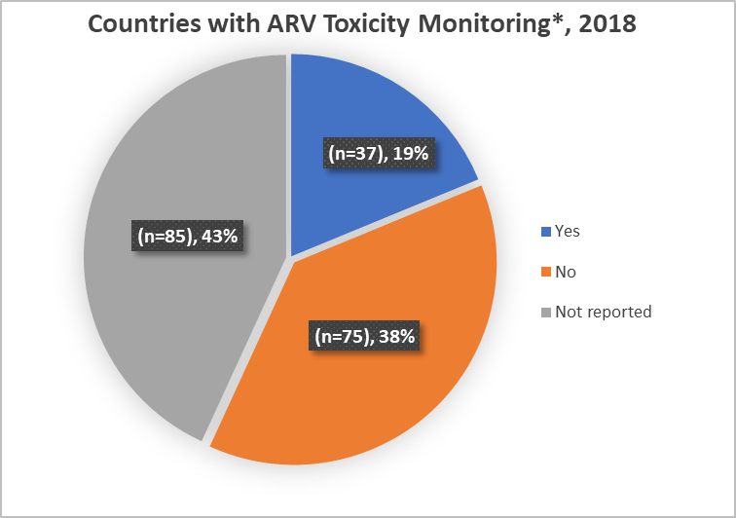
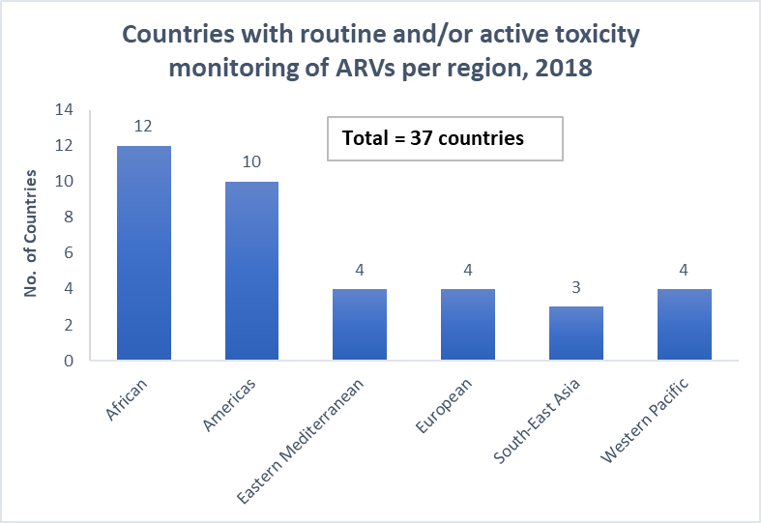
Country implementation of ARV toxicity monitoring as of mid 2018
*ARV toxicity monitoring approaches
Routine monitoring
Active surveillance (general population)
Pregnancy registry/birth defect surveillance
Majority of countries (18/37) reported monitoring ARV toxicity via routine HIV patient monitoring system
Source: Global AIDS Monitoring (UNAIDS/WHO/UNICEF) and WHO HIV country intelligence tool, 2018
Notes:
Type of ARV toxicity monitoring approaches
Active surveillance only: 9 countries
Routine monitoring only: 13 countries
Routine monitoring & active surveillance: 1 country
Routine monitoring and pregnancy registry/birth defect surveillance: 2 countries
Routine toxicity monitoring & active surveillance & Pregnancy registry/birth defect surveillance only: 2 countries
Type not reported: 10 countries

Slide 7
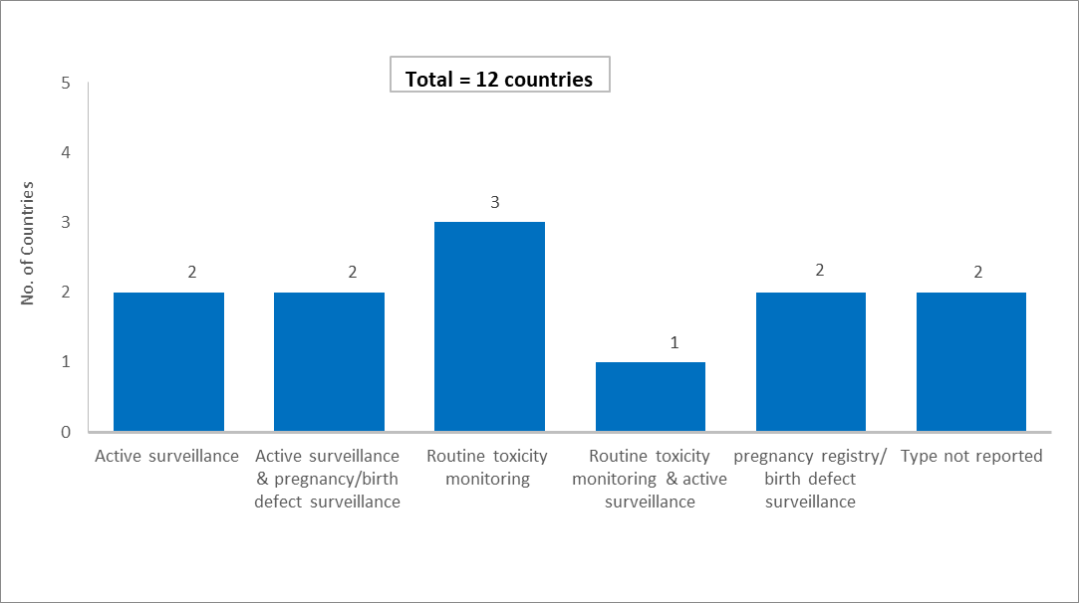
Country implementation of toxicity monitoring approaches to monitor ADRs to DTG, as of mid 2018
Total of 4 countries reported DTG pregnancy registries/birth defect surveillance
Botswana
Brazil
Malawi
Uganda
Source: Global AIDS Monitoring (UNAIDS/WHO/UNICEF) and WHO HIV country intelligence tool, 2018
Notes:
Active surveillance only: Egypt & Sierra Leon
Routine monitoring only: Argentina, Cuba and Kenya
Routine monitoring & active surveillance: Comoros
Active surveillance and pregnancy registry/birth defect surveillance: Botswana & Brazil
Pregnancy registry/birth defect surveillance only: Malawi, Uganda & South Africa
Type not reported: Poland and Samoa

Slide 8
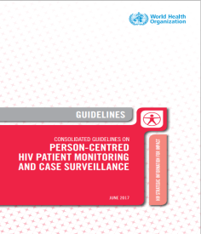
WHO ARV Toxicity Monitoring Tools Available
Strengthening routine toxicity monitoring via HIV patient monitoring system
WHO toxicity monitoring implementation tool for Hepatitis and HIV

Slide 9

WHO Global Surveillance of drug safety in pregnancy
WHO / TDR
Central registry for epidemiological surveillance of drug safety in pregnancy
SOUTH AFRICA
BOTSWANA
OTHERS ….
MSF, Brazil, MOZAMBIQUE
UGANDA
MALAWI
ARV pregnancy registry : National Department of Health and WHO technical support
Two provinces Kwazulu Natal (since 2013) and Western Cape Province (2018)
Plan: expand to Gauteng Province
University of Cape Town
MoH Gauteng Province
Birth defect surveillance project with CDC funding and WHO technical support, 2016 - 2020
Queen Elizabeth Hospital in Blantyre 8000 deliveries, 1000 HIV positive, 37 babies with major birth defects - at end July 2017
Expansion in September 2017 at Mangochi and Ntcheu, and Bwaila Hospital, Lilongwe – 4 sites
Methodo: (i) surveillance maternal and birth outcomes (ii) case –control study examining risk factors associated with major BDs
MoH Botswana Harvard Partnership
Tsepamo study
Approximately 88,000 births , 15 000 HIV positive on ART, as of April 2018
3200 exposed to DTG based regimen
NTD signal May 2018
More sites
Pregnancy registry starting - MSF in Malawi, Mozambique initiating, Uganda (CDC protocol) , Kenya, …
http://www.who.int/tdr/research/tb_hiv/drug-safety-pregnancy/en/

Slide 10
Central DTG active monitoring repository
UNITAID partnership
WHO / TDR central database for safety evaluation of DTG
South Africa
MoH and UCT
Botswana
MoH, IACAP
Brazil
MoH
Kenya
MOH and IACAP
Surveillance for treatment-limiting toxicity due to dolutegravir Falls 2018
3 ART sites in WC province Gugulethu, Khayelitsha and Mapongwana CHCs
450 new patients / month (total 6000 Y3) + patients shifting to DTG if needed
+ ART site(s) in other province tbd with DoH
As of dec 2017, 2000 patient using DTG in 24 sites
Active monitoring with MoH and IACAP on going
National scale up planned for July 2018 – 400,000 patients moving to DTG
Approximately 50,000 patients are receiving DTG (38,000 first-line initiations, 12,000 treatment switches to DTG)
Extension of the pregnancy surveillance study to general population using dolutegravir
Approximately 2,000 new initiations/month
As of dec 2017, 55000 patient using DTG
Active toxicity monitoring lead by MoH
Approximately 2,000 new initiations/month
http://www.who.int/tdr/research/tb_hiv/drug-safety-pregnancy/en/

Slide 11
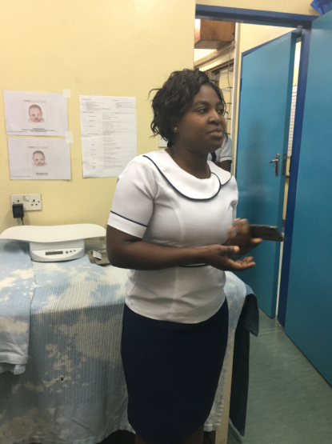
Next steps
MAKING SURVEILLANCE DATA USEFUL
WHO sub-committee on safety of dolutegravir first meeting
  - September 2018
WHO / TDR Central registries for epidemiological surveillance of drug safety in pregnancy and for DTG in all populations
  - Consolidating on going engagement and data sharing
  - New contributors Brazil, Kenya , MSF, CDC…

Slide 12
Technical Contacts & Area of Expertise
Meg Doherty - Coordinator Treatment and Care (dohertym@who.int)
Marco Vitoria – Adult treatment (vitoriam@who.int)
Martina Penazzato – Paediatric treatment (penazzatom@who.int)
Lara Vojnov - Lab diagnsotics and monitoring (vojnovl@who.int)
Francoise Renaud – Pharmacovigilance (renaudf@who.int) and Hiwot Haile-Selassie (haileselassieh@who.int )
Silvia Bertagnolio – HIVDR (bertagnolios@who.int)
Boniface Dongmo Nguimfack – PSM (dongmonguimfackb@who.int)
Christine Halleux – TDR (halleuxc@who.int)

